Slide 2
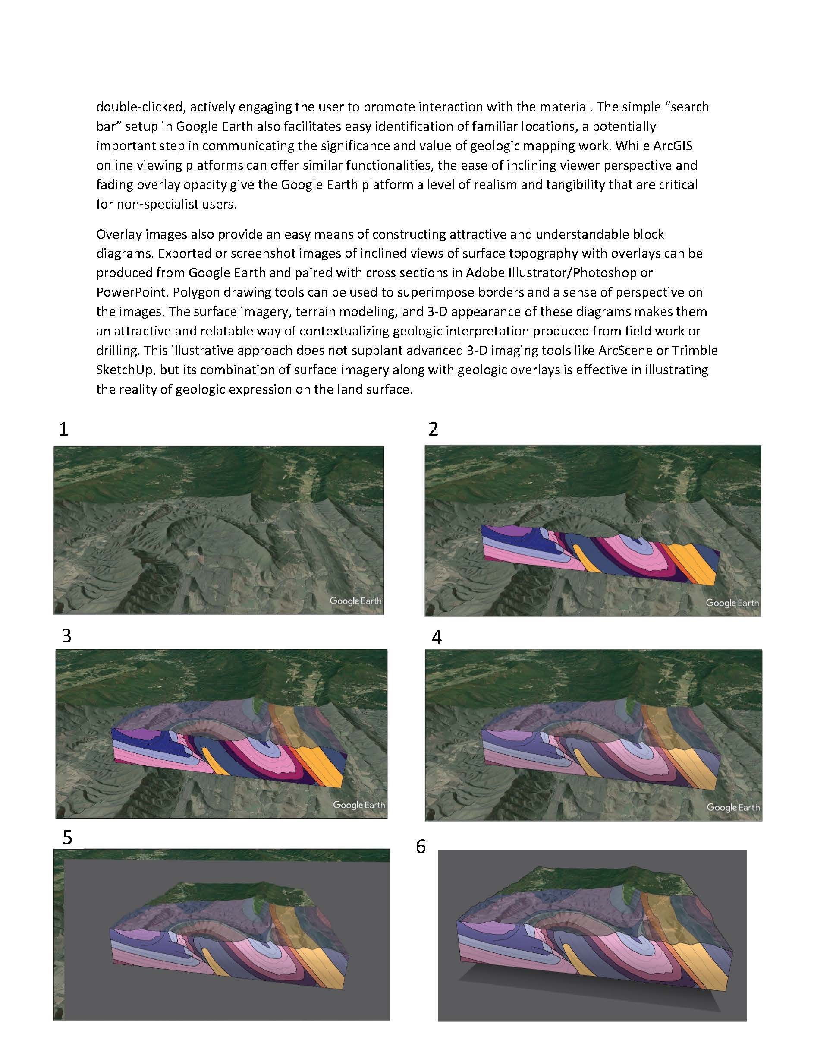

Slide 3
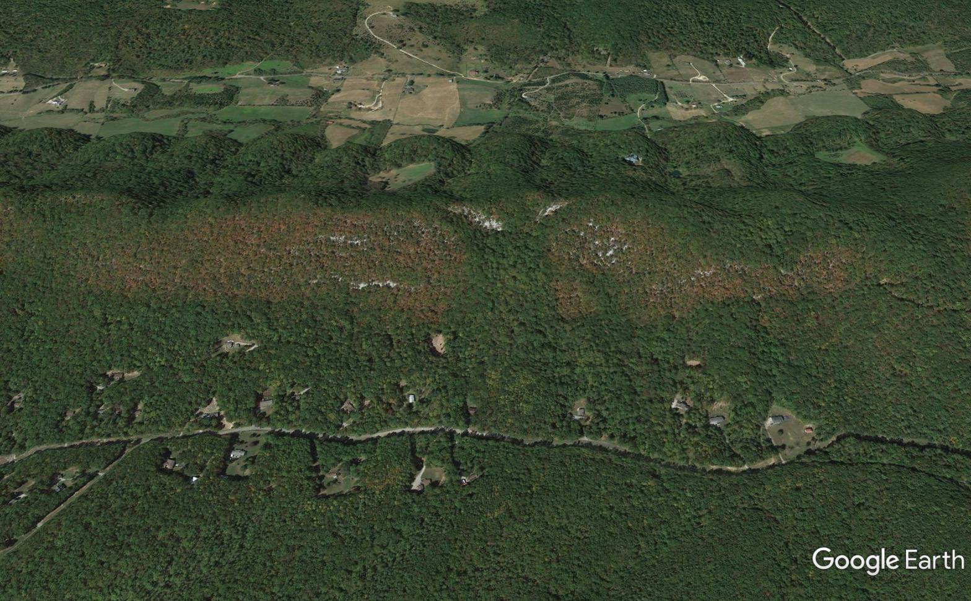
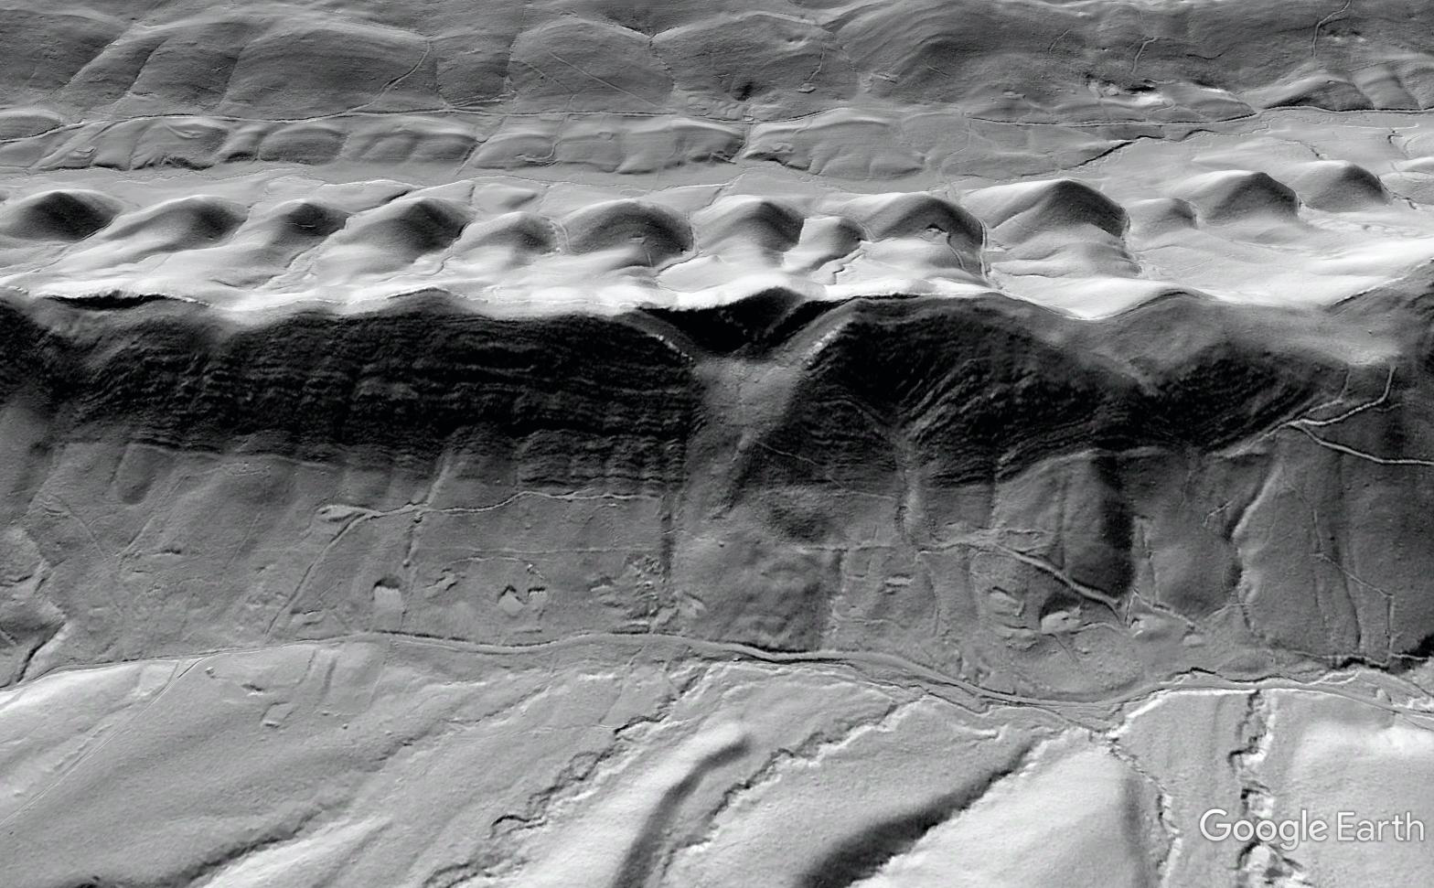
*animated!
Run as a slide show and keep advancing
psprince@vt.edu
philip.prince@dmme.virginia.gov
What’s this green stripe?
LiDAR shows it’s an ancient landslide…
LiDAR overlays enhance the publicly available, easily used Google Earth platform

Slide 4
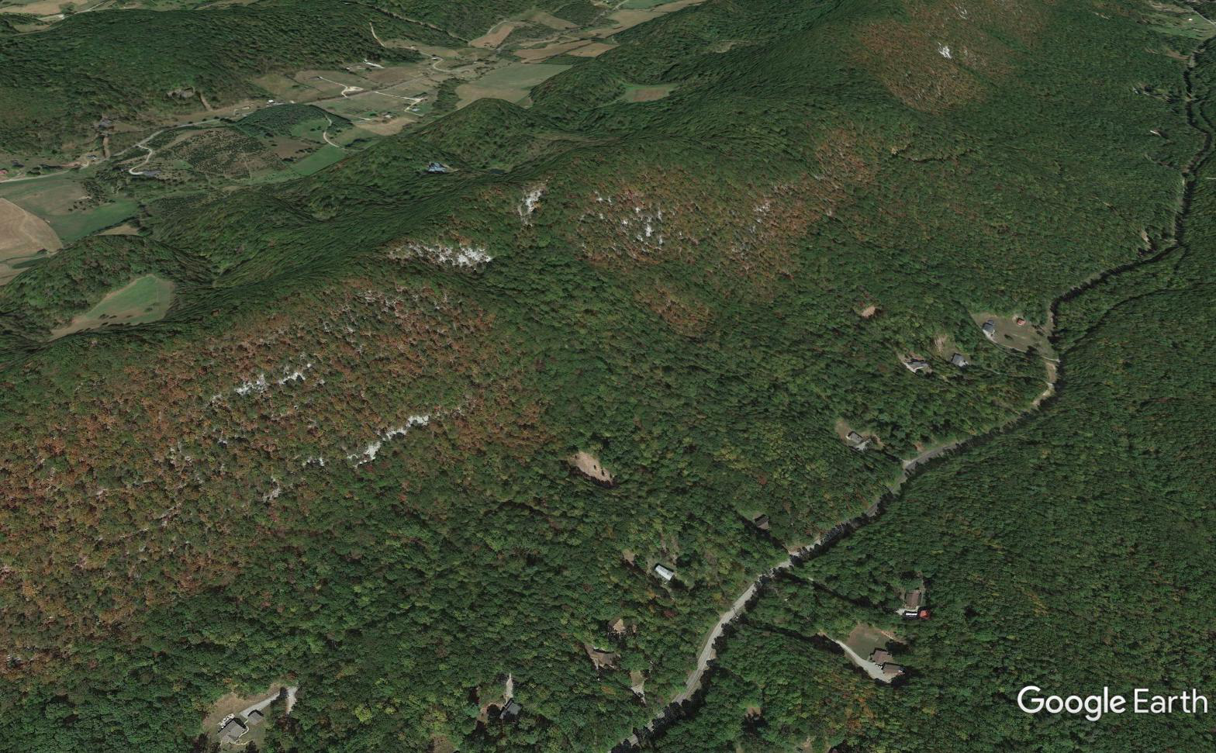
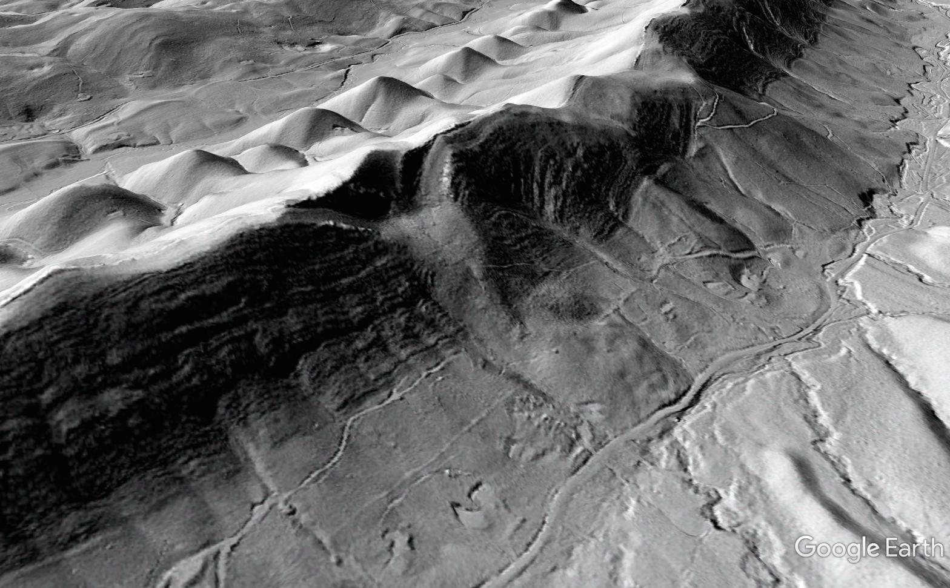
Landslide detached in shales near the base of the sandstone package
LiDAR makes it easy for anyone to see that this mountain is a resistant sandstone outcrop zone with steep dip (layered structure visible)
Can I drill a well through this disgusting shale and into the sandstone?
…Not from your house; layers dip too steeply and are too deep…

Slide 5
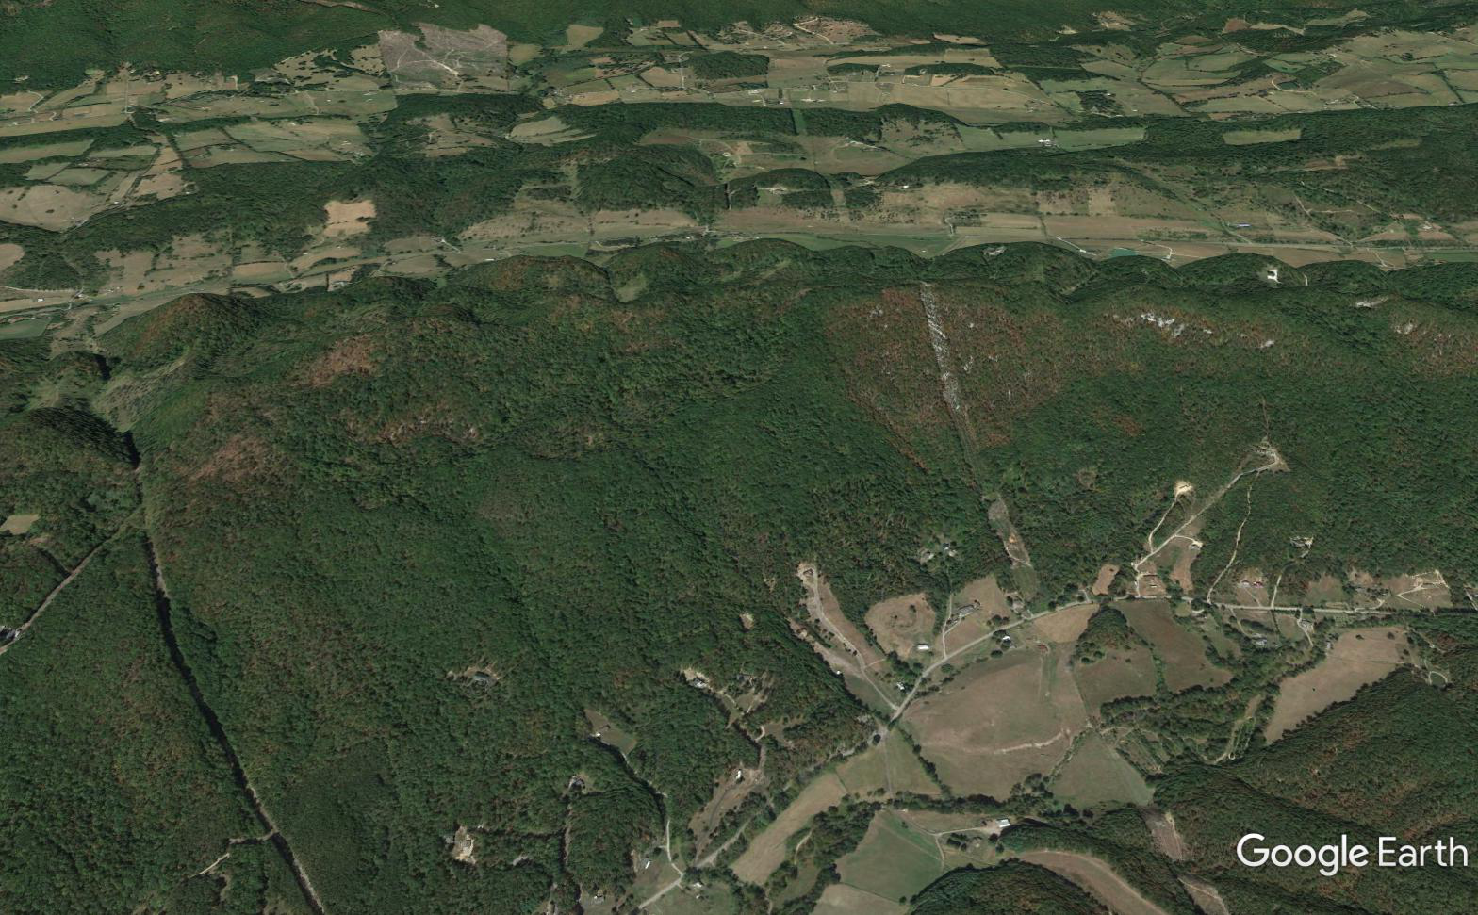
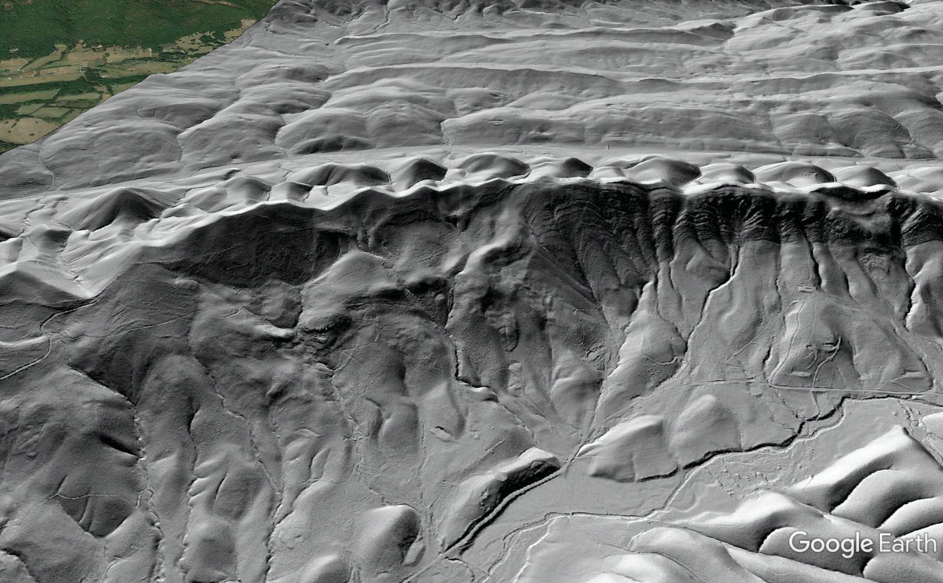
This large translational slide, also stratigraphically controlled, becomes visible with LiDAR overlay
Same detachment horizon as previous example…
Can you convince these folks using this satellite photography format?

Slide 6
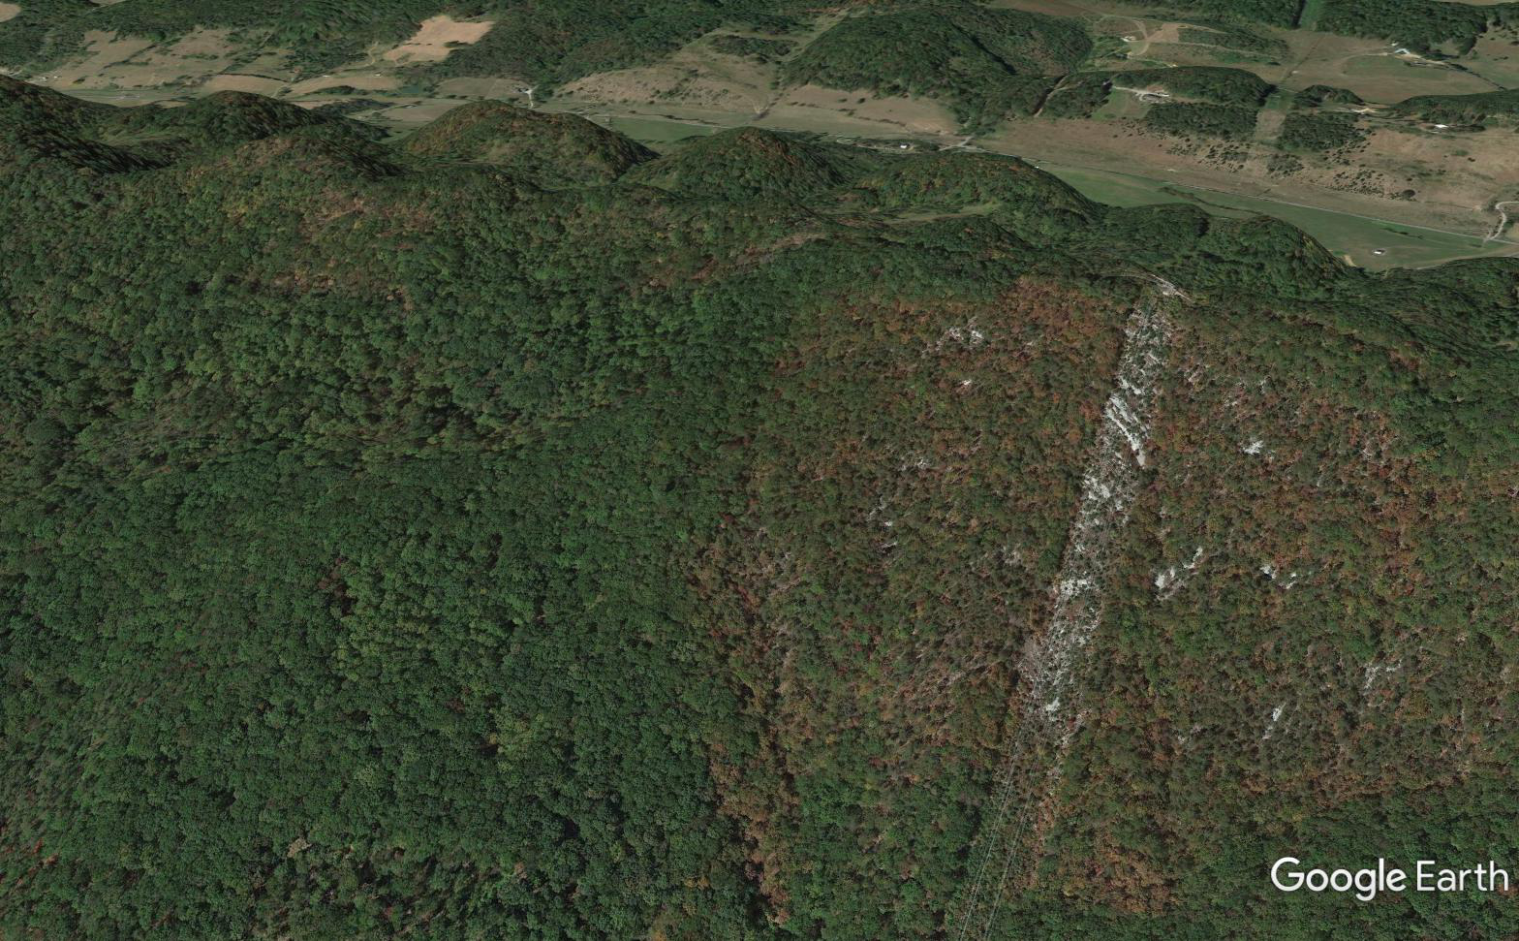
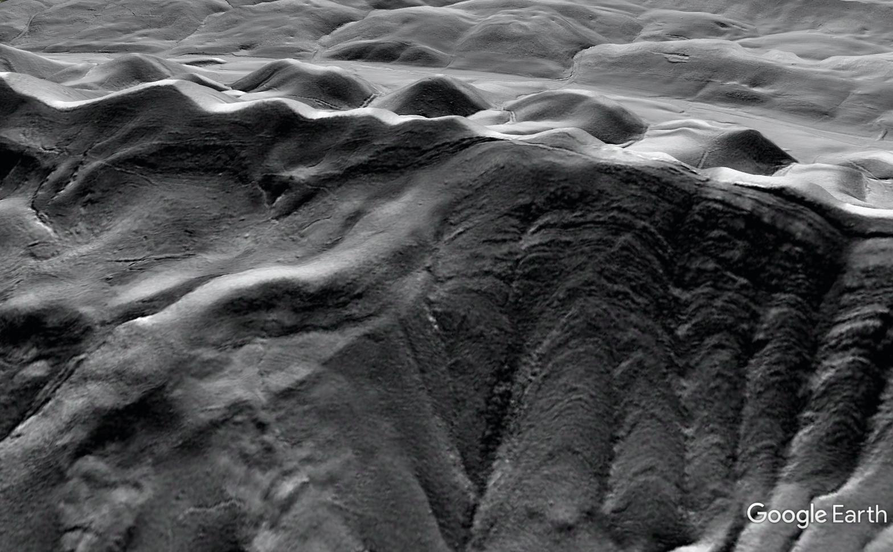
Scientifically, LiDAR is essential to place features into an appropriate process context (Paleozoic fault that rotated to present position with the rest of the thrust sheet, or a later feature?)
For the geologist/specialist, contact between detached beds and intact beds can be located easily

Slide 7
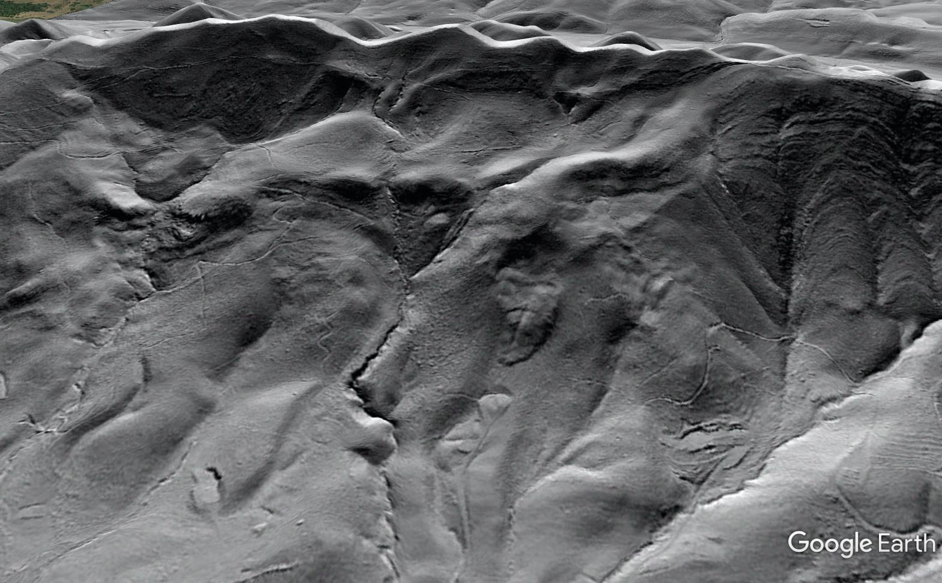
Smaller and younger failures that may be of engineering/hazard interest are readily identified AND communicated to non-specialists

Slide 8
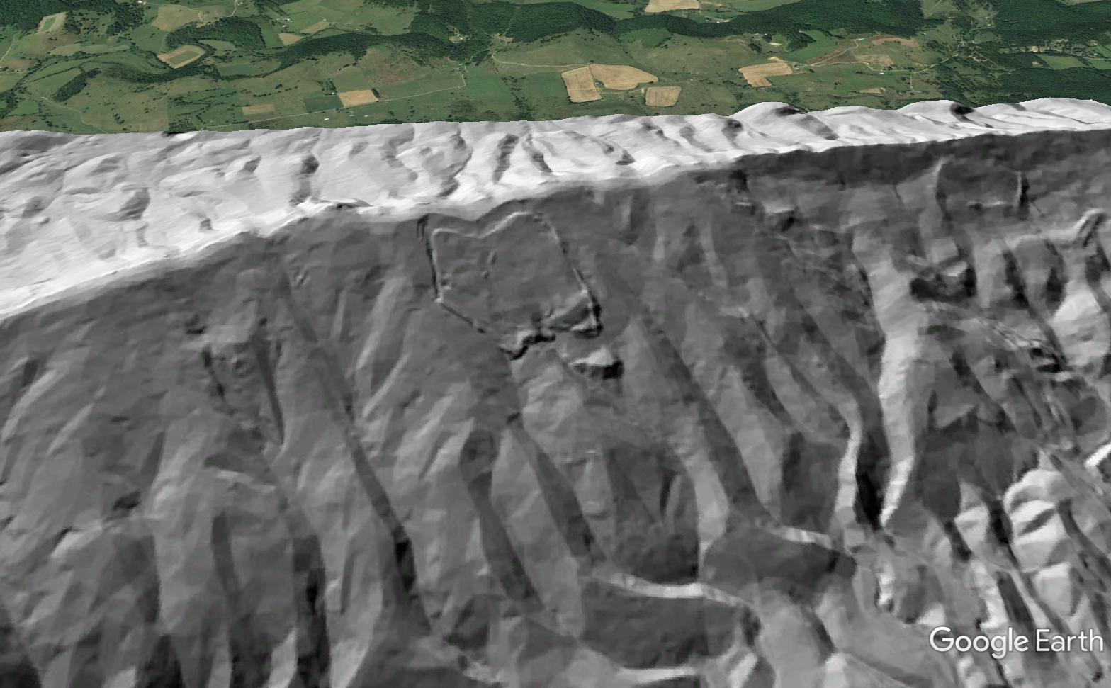
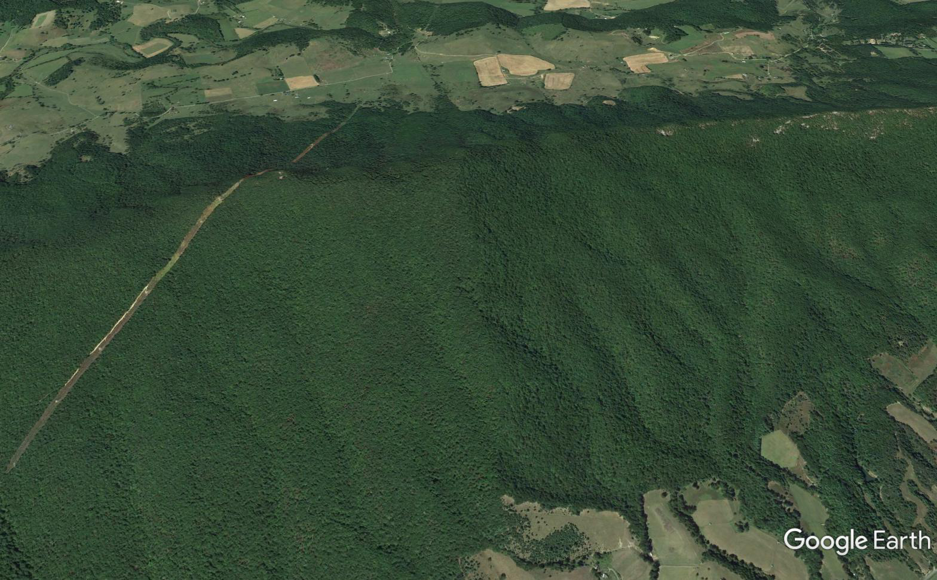
Great anticlinal toe!
Nothing to see here…or is there?

Slide 9
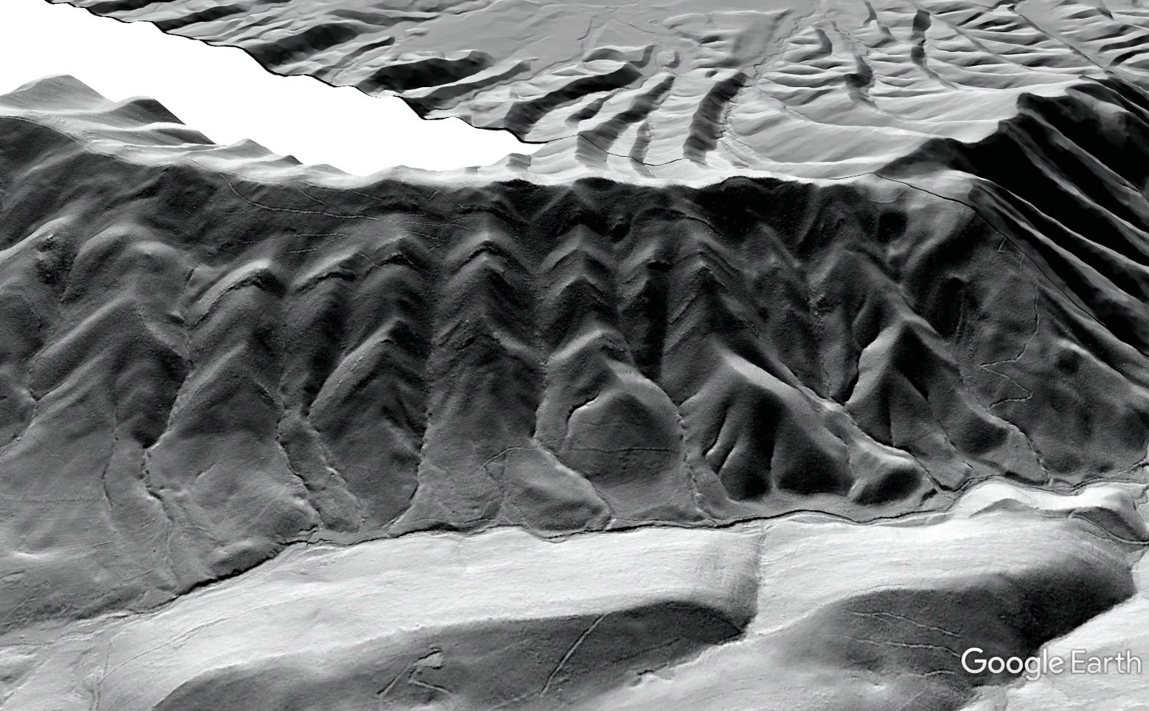
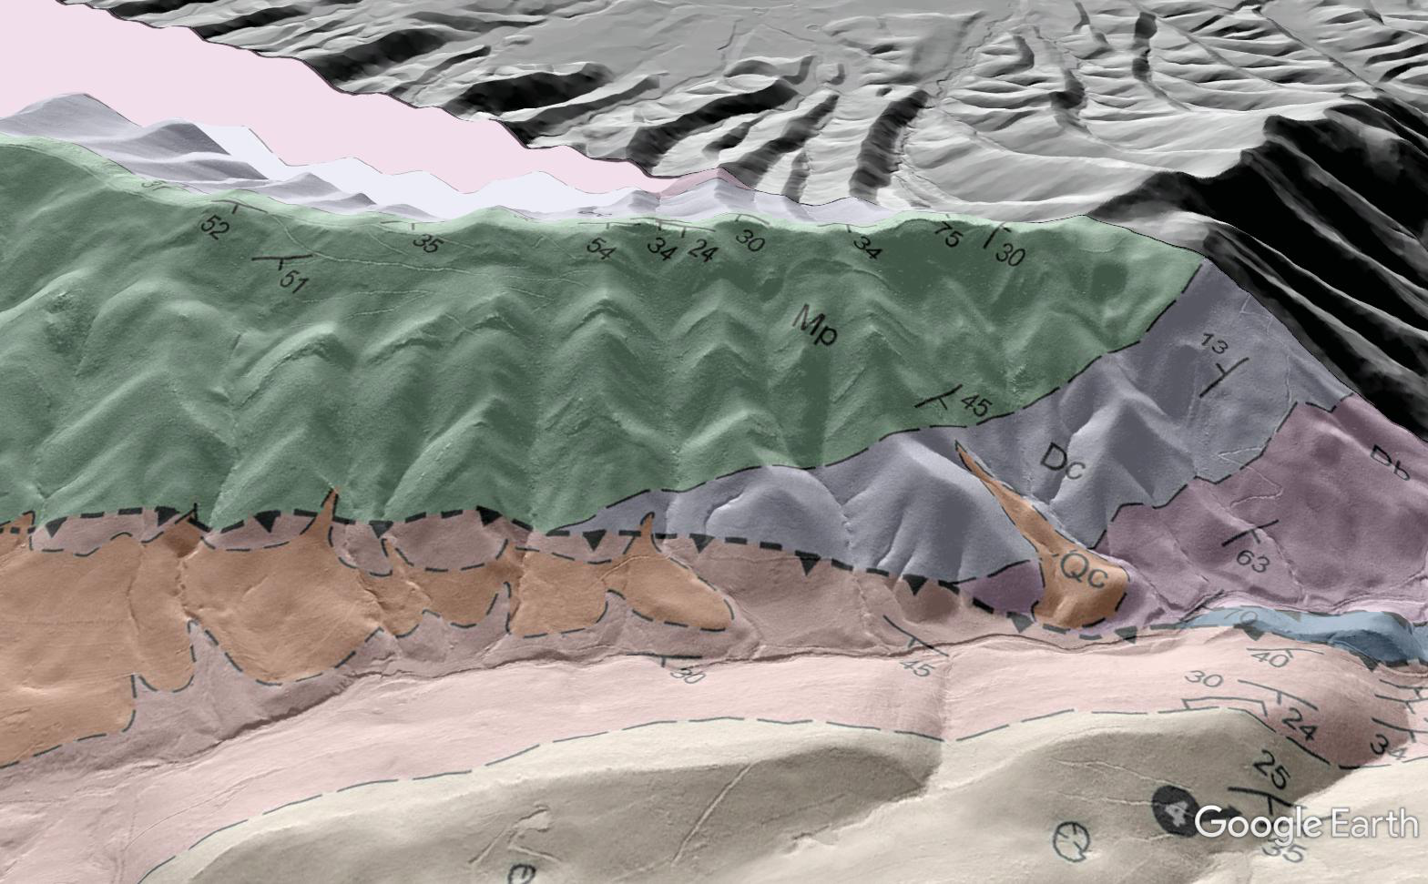
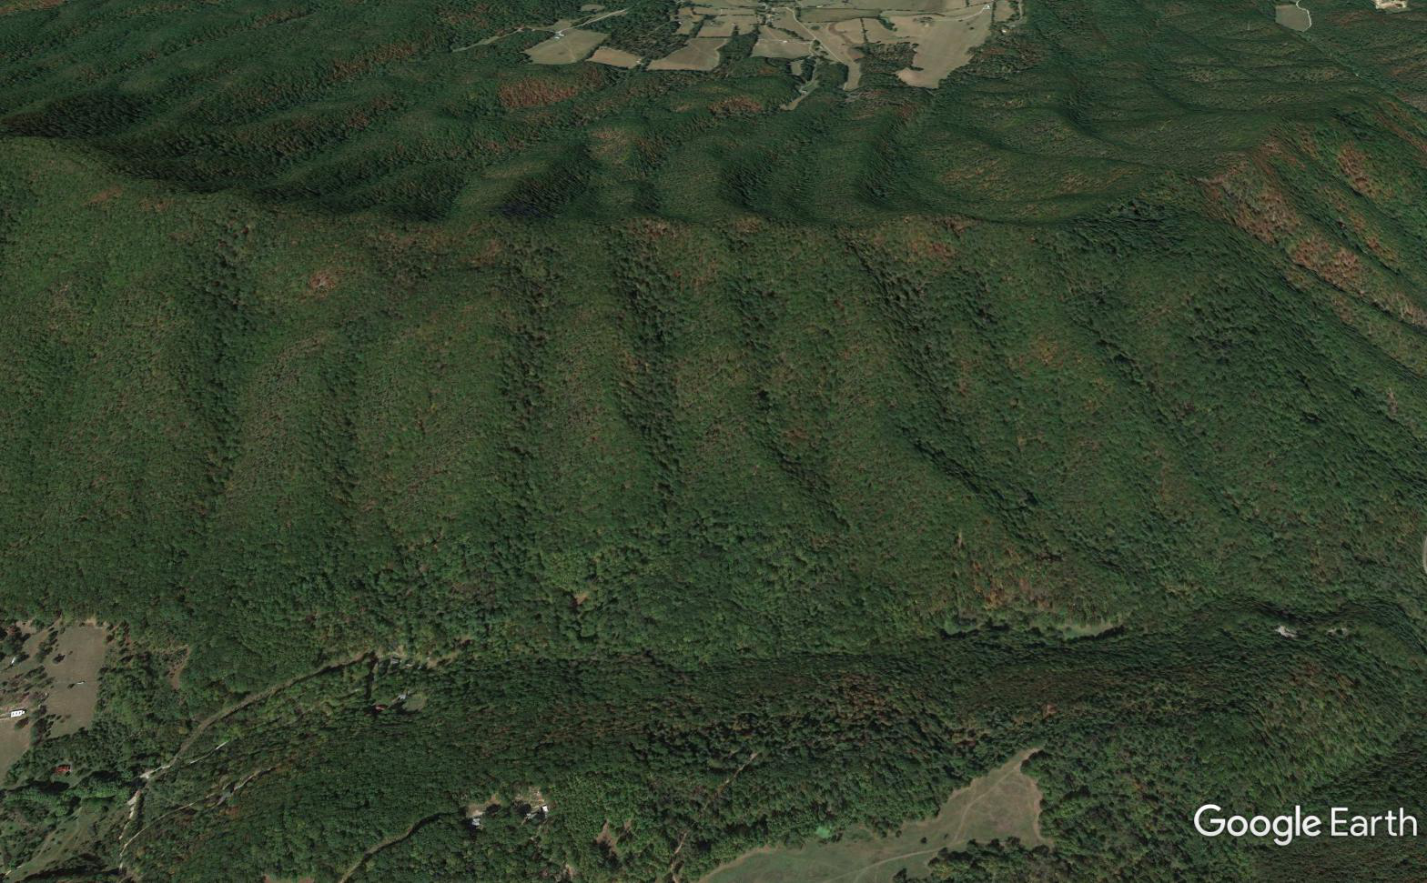
Overlays can also enhance communication of structural concepts
…reflect contacts that are clearly visible in LiDAR
Slight drafting errors
Green and blue sandstone horizons go under the peach carbonate unit—easier to explain with an image
Subtle clues in vegetation

Slide 10
Advanced structural interpretation, and a good story…
The Cove Mountain “2”

Slide 11
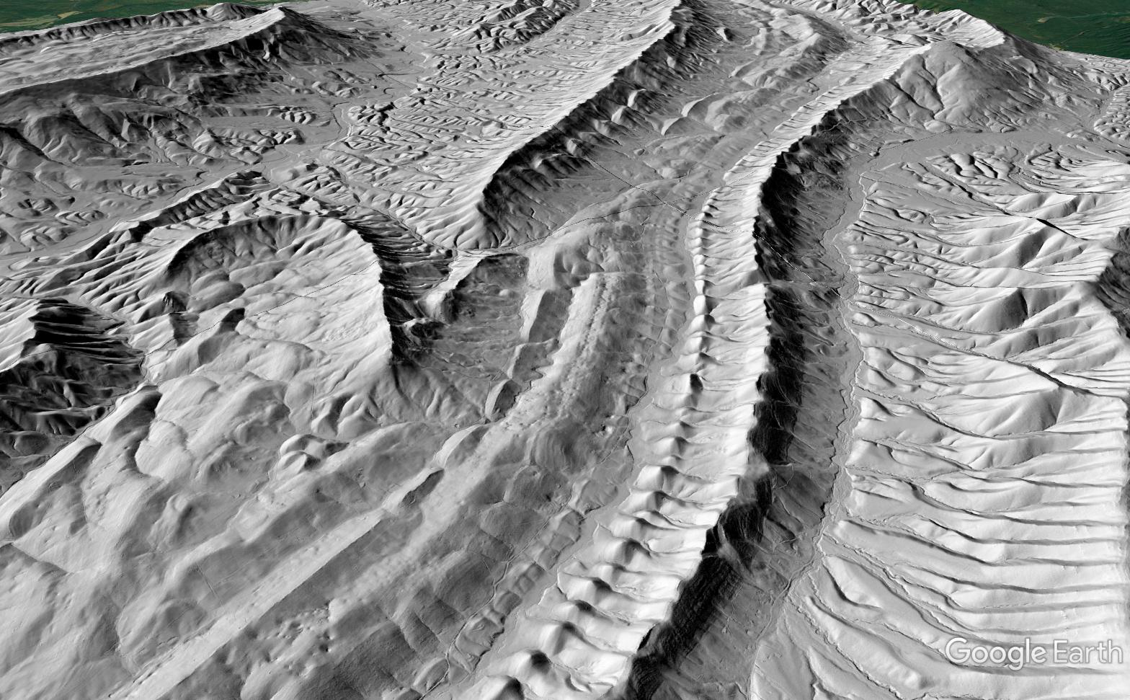
These horizons are the same age and facies…but they are fault-separated. Is it a splay or master fault separation? Regional interpretation depends on it…

Slide 12
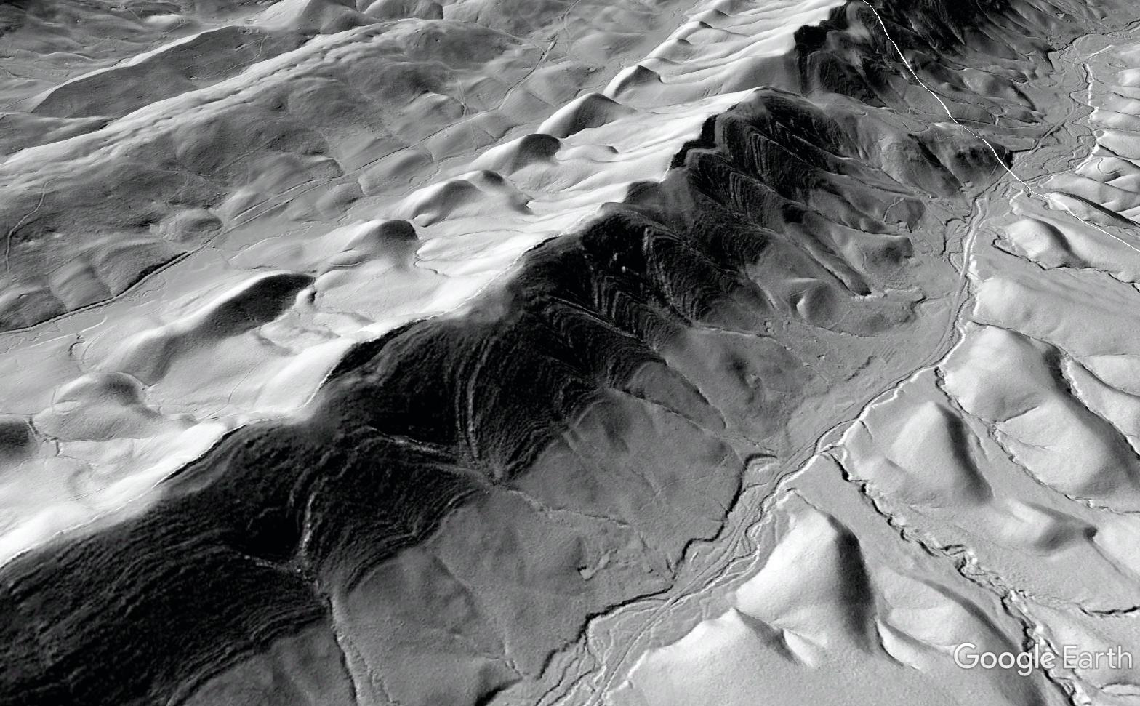
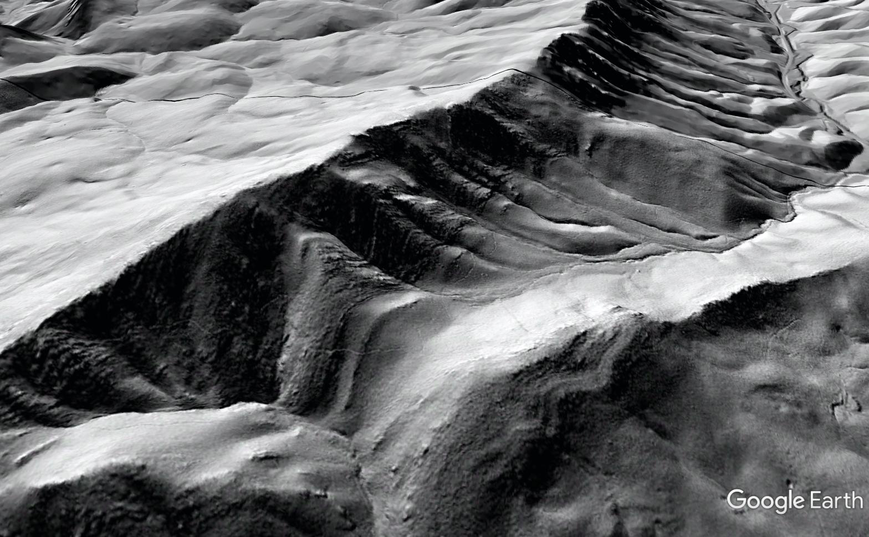
Cove Mountain
Catawba Mountain
Signficant stratigraphic differences support master fault separation…VERY difficult to interpret on forested, mantled slopes
Thick shale
Carbonate beds (no outcrop)
Thin shale at base
No carbonate

Slide 13
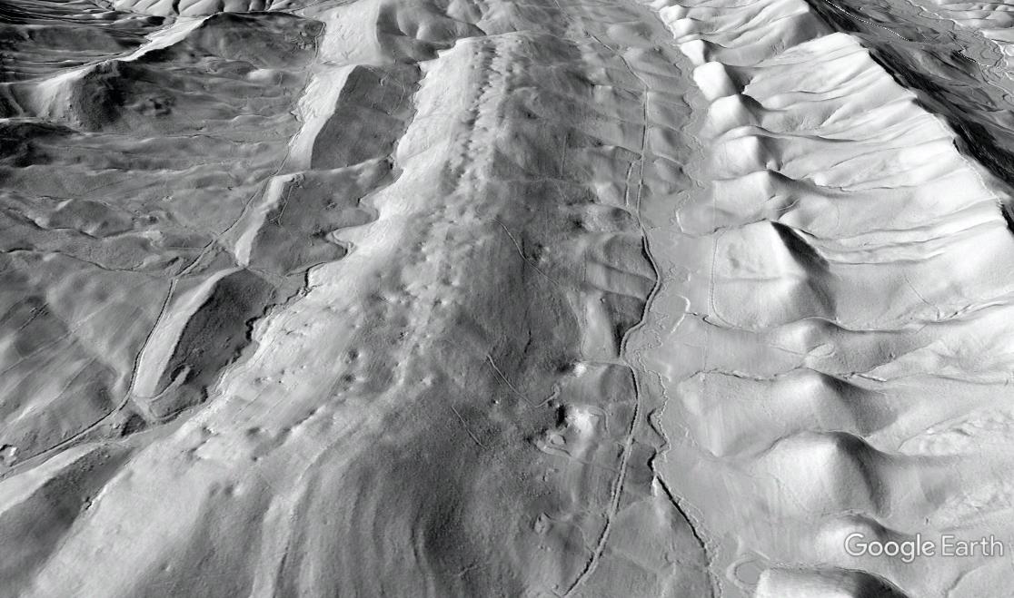
Overlays can also provide useful context for conservation/water quality application
Bad stuff goes in elevated sinkholes
…and comes out in valley springs

Slide 14
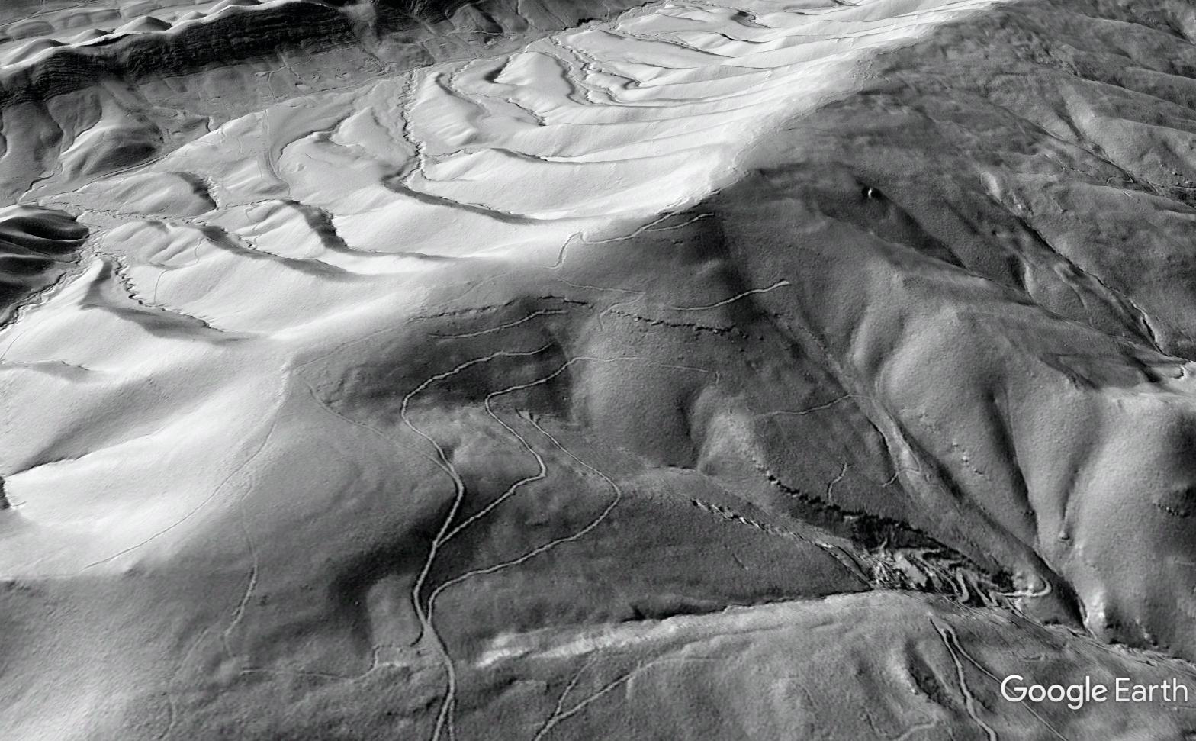
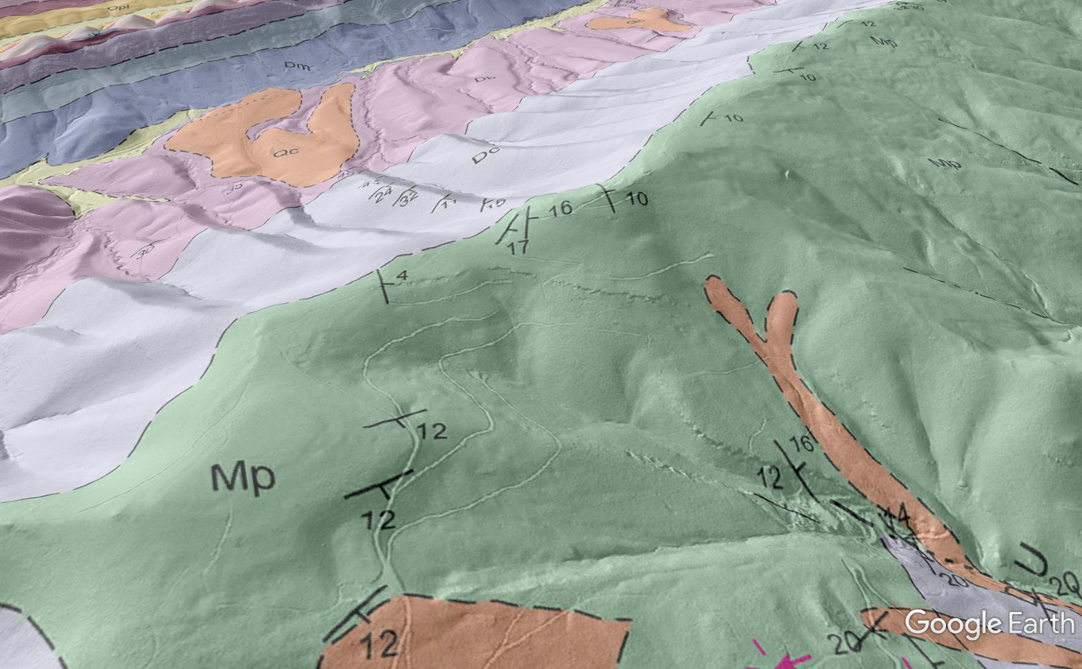
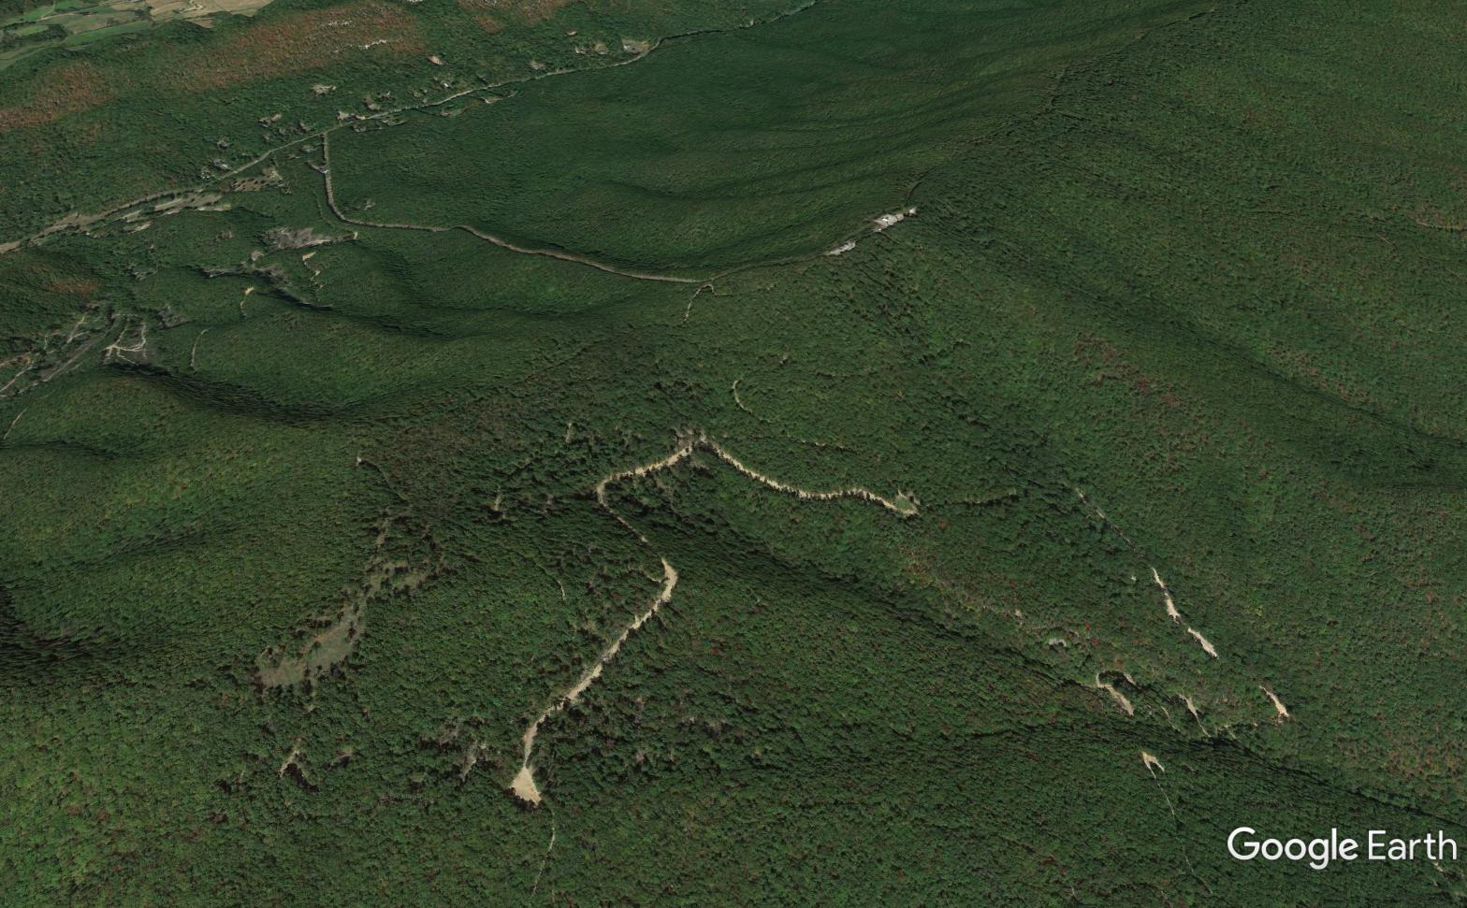
From the communication perspective—
What are mapping geologists doing? What do they look for? Where do they have to go and why?
Great natural outcrop…appears to be very low dip
Structural measurements in roadcut
Additional outcrop measurements track changing dip…great exposures
Measurement consistent with obvious bed orientation (correct plane to measure as bed surface is not always clear in highly intersected/damaged rock)

Slide 15
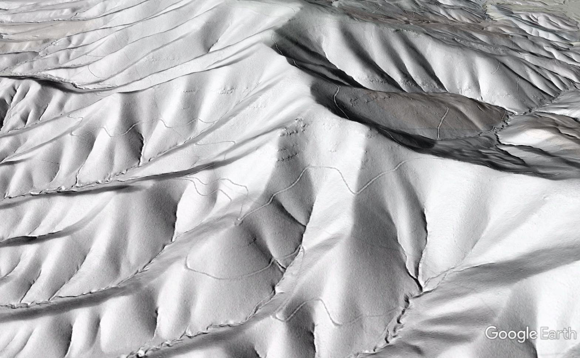
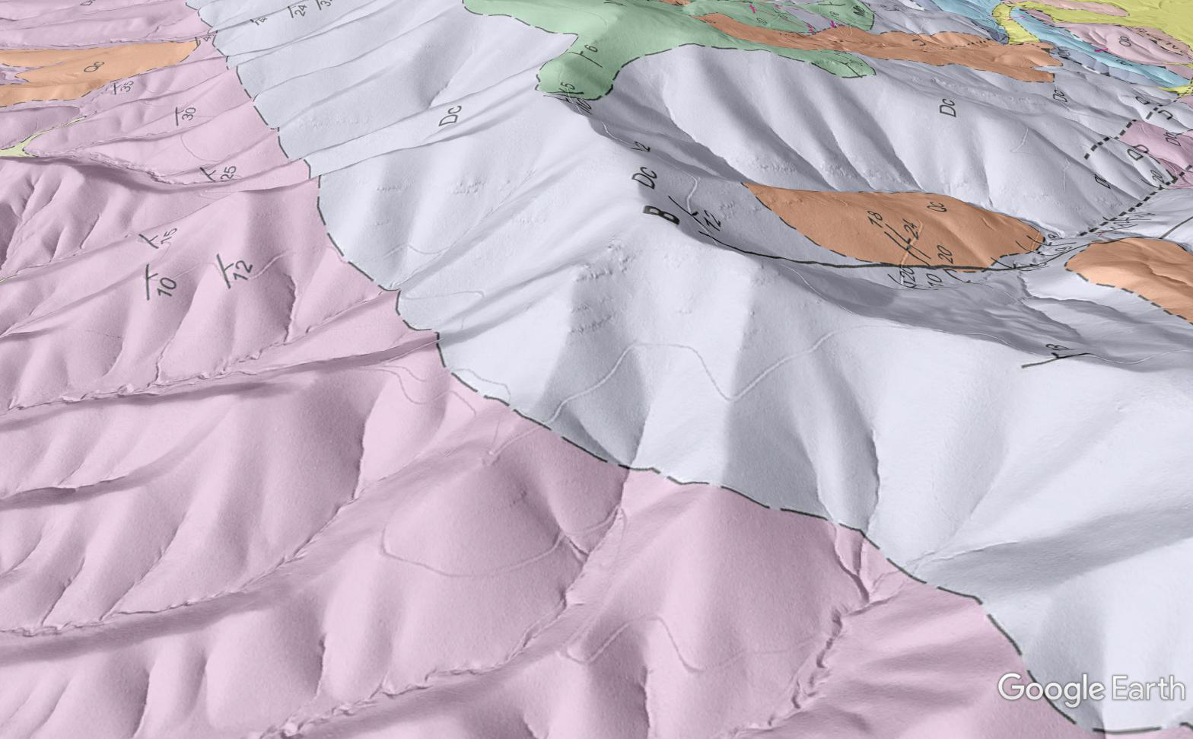
Key data points missed in initial, pre-LiDAR mapping…they need a visit!
Can we use your logging road?

Slide 16
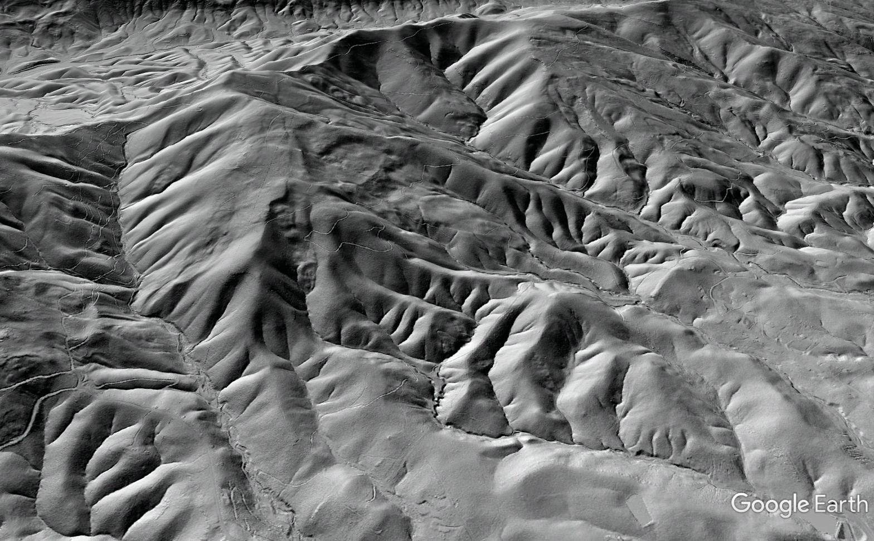
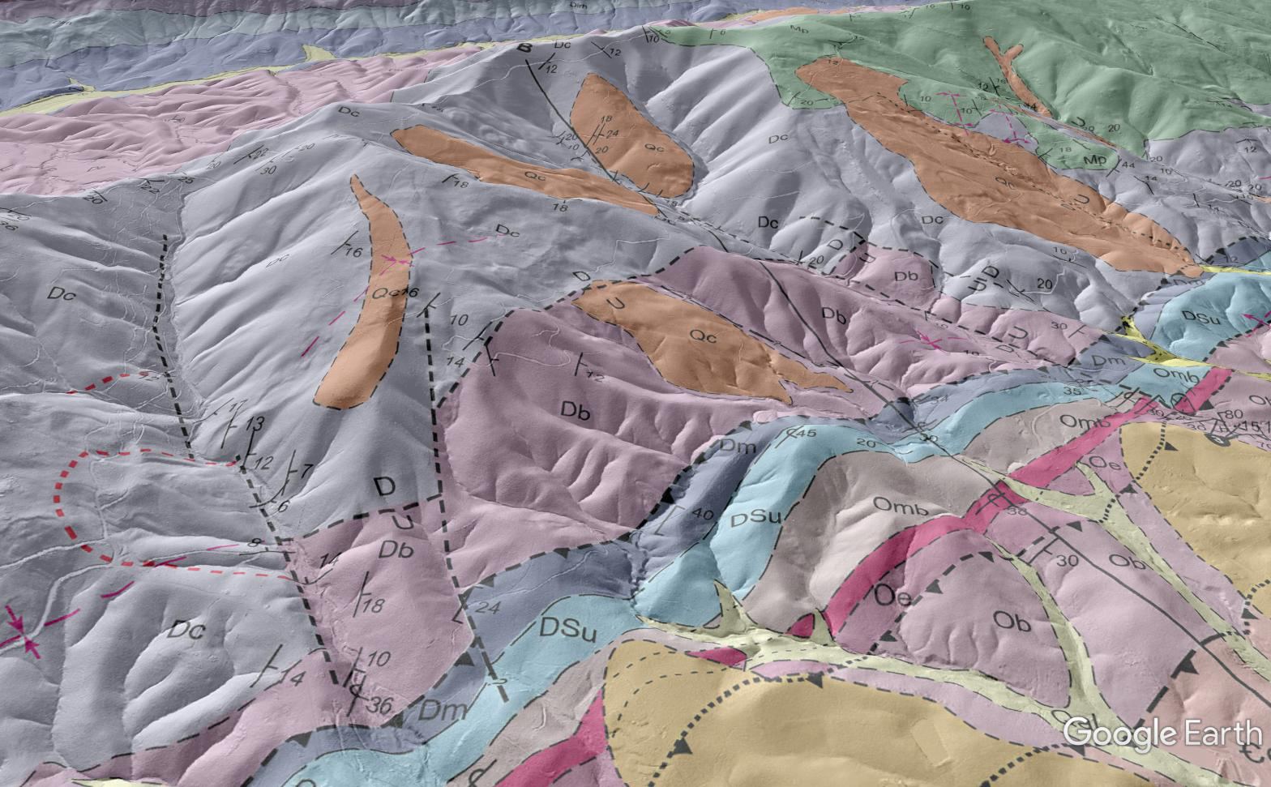
It may be useful to show property owners (and yourself!) road networks that may be used…as well as the grandeur of their land holdings!
Drafting errors…
Colluvium field covers
Obvious in-place outcrop
Db contact should be closer to drainage density shift

Slide 17
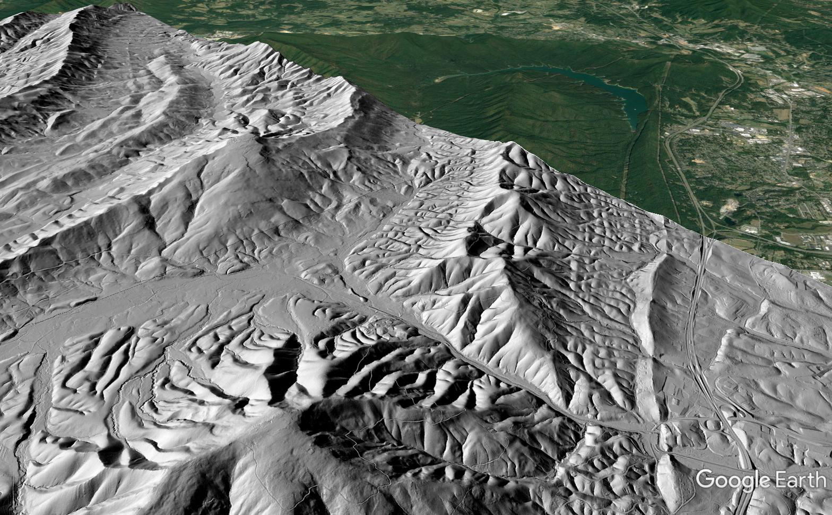
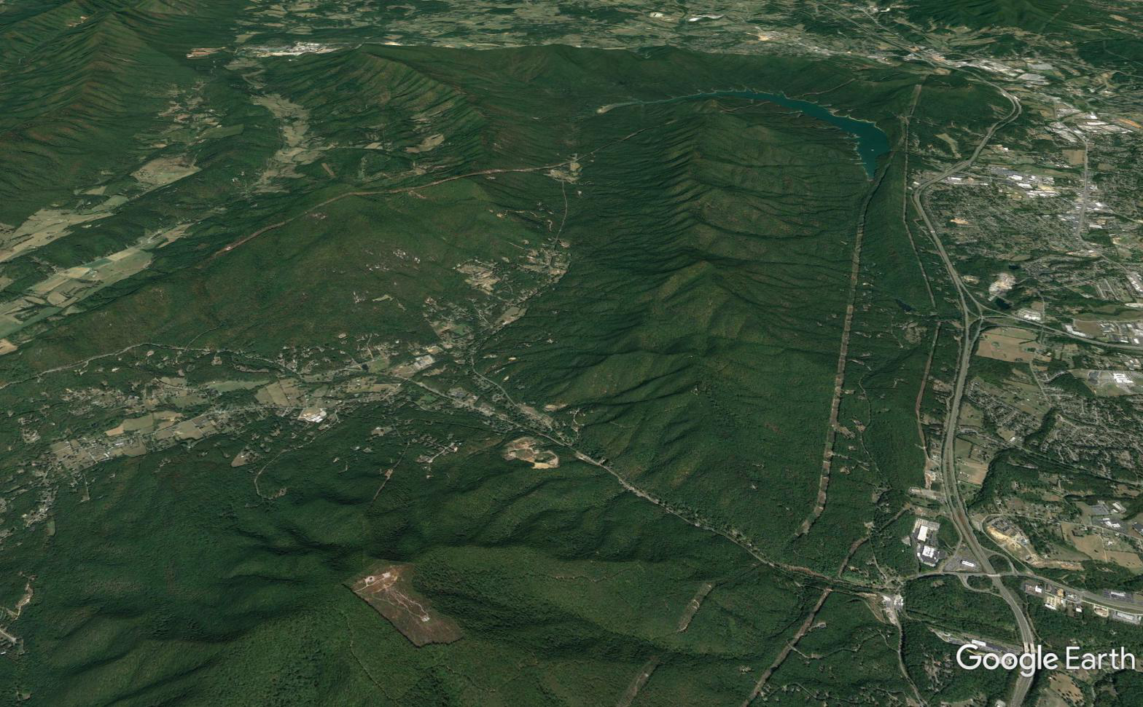
These mountains look different (smooth slopes vs. rugged) because they are underlain by different rock units!
Large-scale visualization…high drainage density areas are the same rock unit (synclinal hinge zone)
This sandstone often makes smooth slopes…
…and crops out again over here! (after passing under the middle mountain about 9,000 feet below the surface)
X-section schematic
Thickening in hinge

Slide 18
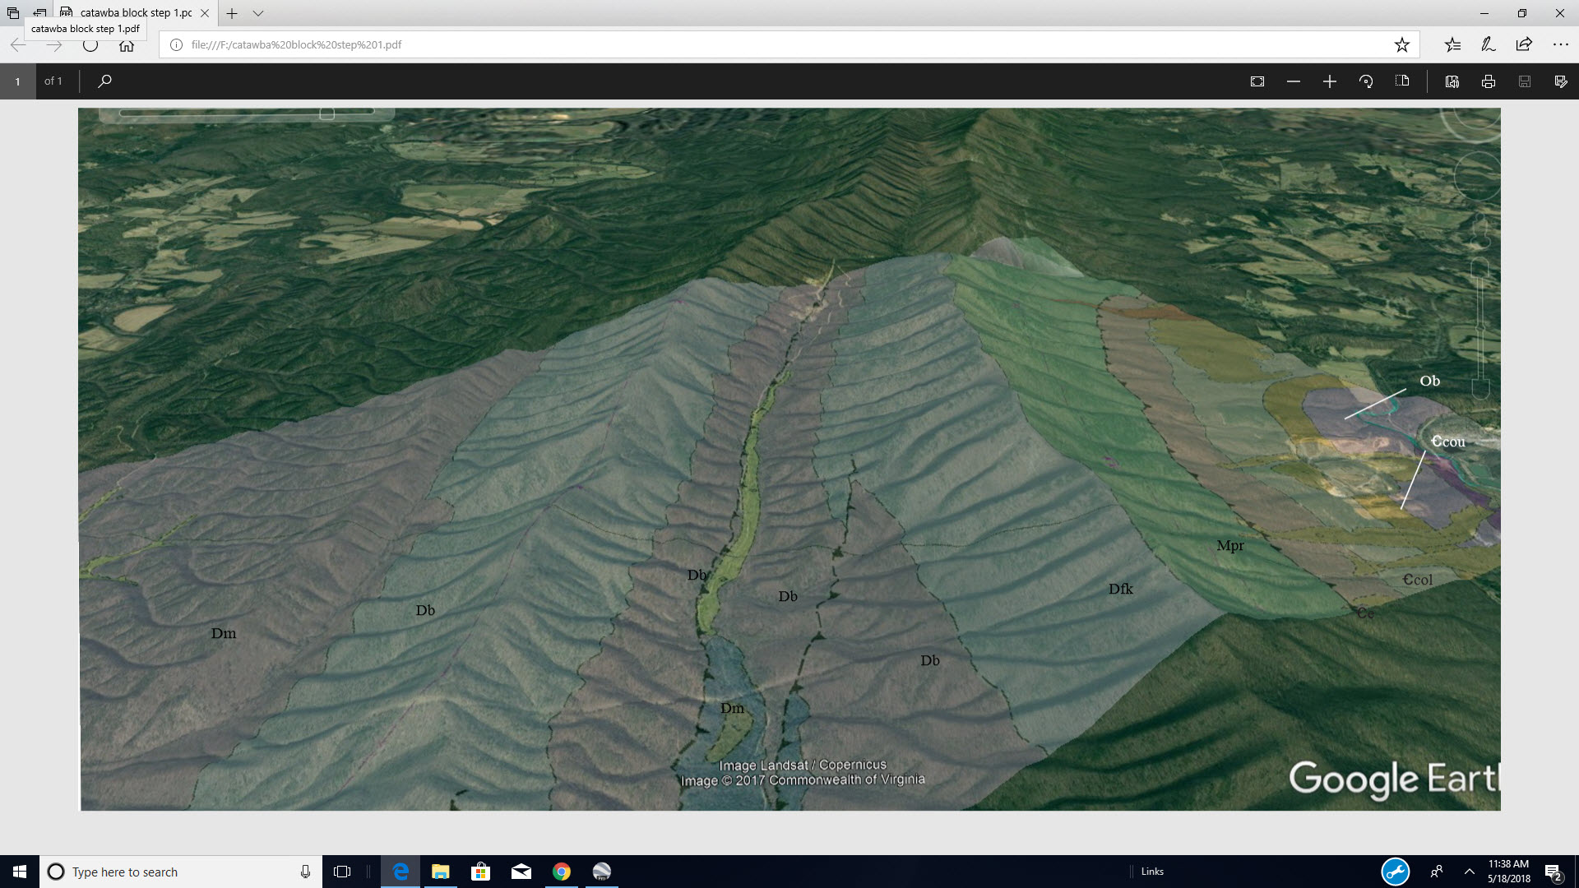
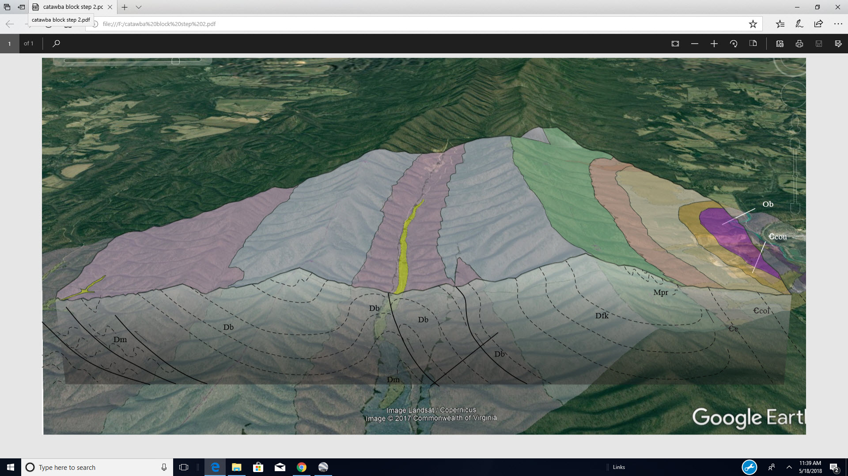
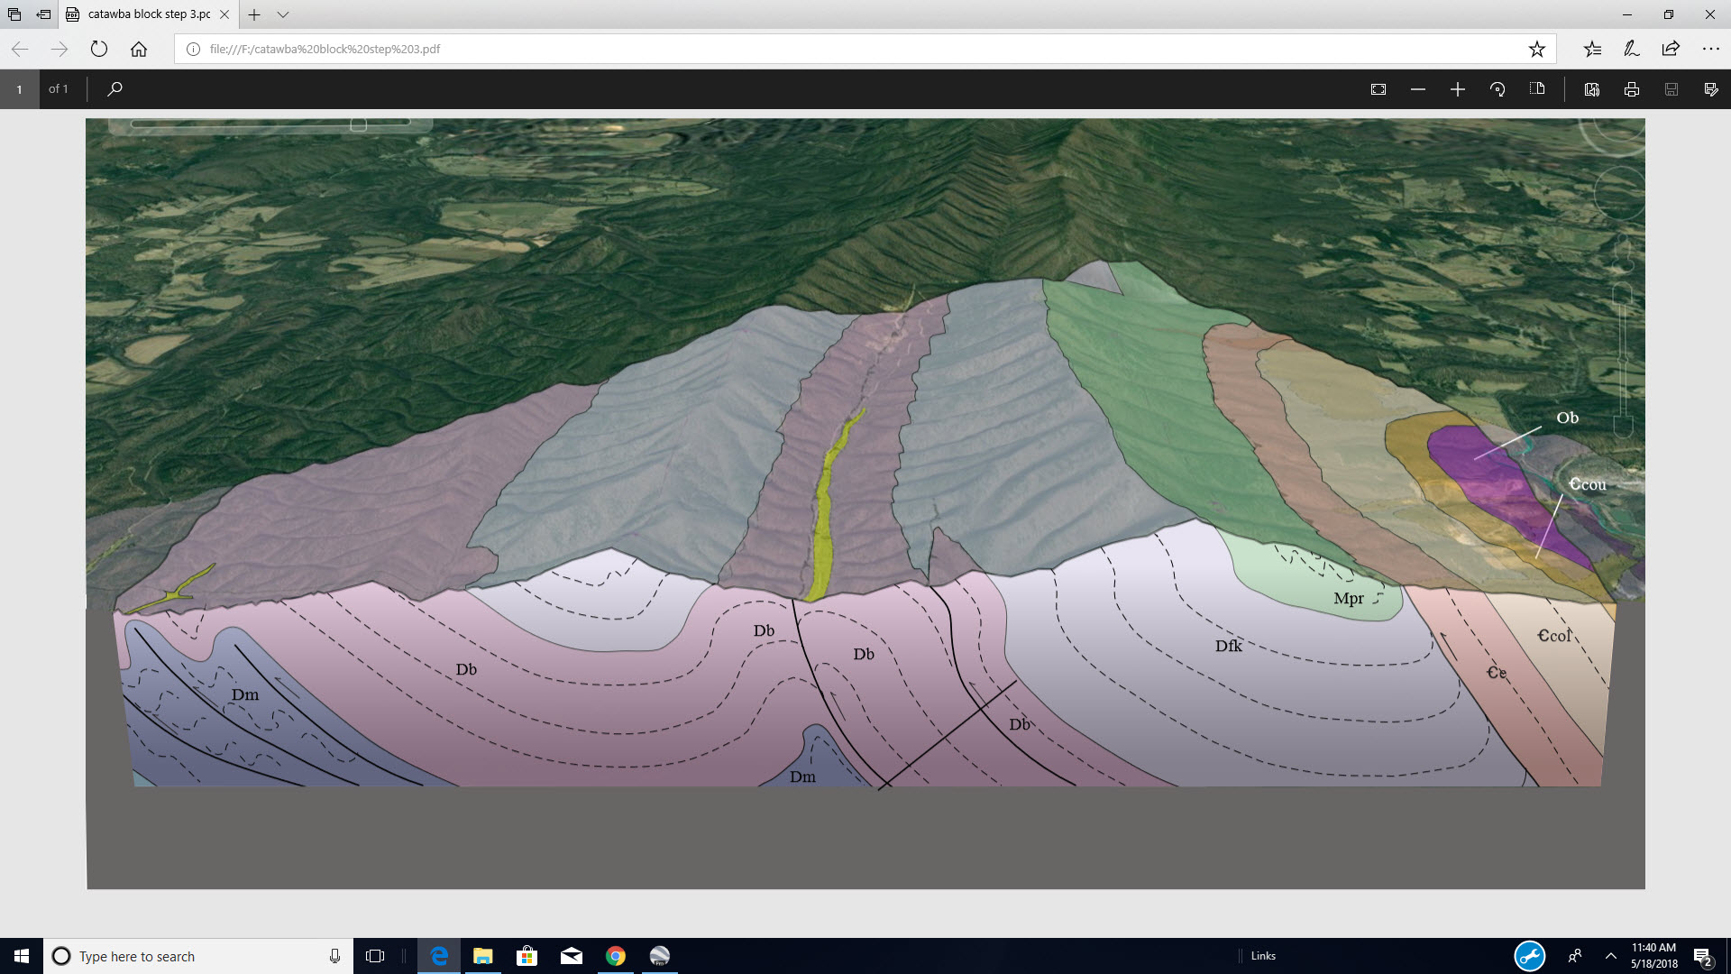
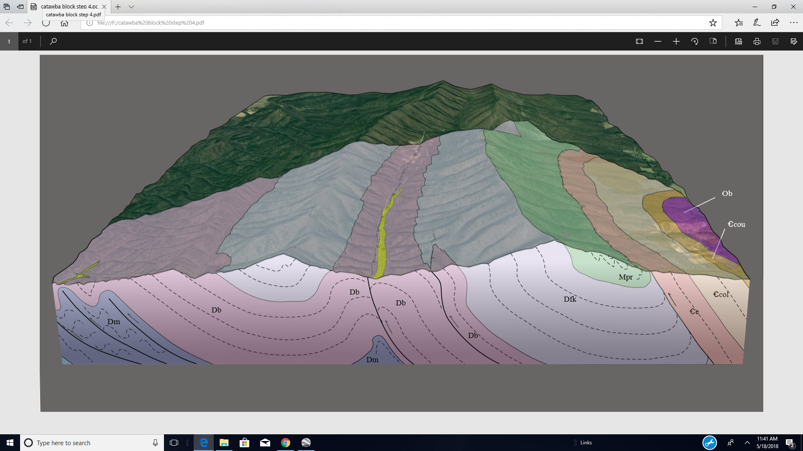
Overlays and Google Earth’s tilt function make block diagrams easy to construct
A screenshot is taken with a known line-of-section running horizontally across it. A clipping mask (Adobe Illustrator) is used to “cut out” the surface of the block, which is mated to the cross section. Gray polygons frame the surface-section pair, with a nice gradient fill polygon below it to make a shadow effect.
psprince@vt.edu for more info!

Slide 19
An overview of our LiDAR overlay procedure
Arc will export .kmz’s, but the quality will be very poor. As far as I know, you have to make your own to end up with “presentation” quality for something like LiDAR.
The first step is the export of the quad as a TIFF at very high dpi; we use 1500. This usually generates a file of ~350 MB.
The TIFF is then opened in Photoshop…

Slide 20
This is where slight imperfection enters the story, and if anyone has improvements, please share!
An unprojected map (WGN, for example) has perfect orthogonal corners, but does not correctly overlay to the elevation model in Google Earth. You therefore have to use a projected map, which is slightly un-orthogonal (geologist’s term).
We rotate the TIFF to match the cropping box as close as possible. With lots of zoom, you can do very well.
What about transparent backgrounds?
You can certainly cut the map out and use a transparent background, but it must leave Photoshop as a PNG to support the transparency. Google Earth can’t digest PNG’s of this size. Small line work PNG polygons are good to go, but a LiDAR overlay of even ¼ quad size will crash Google Earth immediately. Standard cropping saved as a JPEG seems to be the only way to keep the resolution as high as it needs to be in a format that Google Earth can deal with.

Slide 21
Crop the rotated map and save it as a JPEG.
Operating at the quad scale is nice because it permits use of bounding parallels and meridians for georeferencing in Google Earth.
Again, drawing a Bezier box and trimming to a transparent background would be optimum, but I have yet to figure out how to bypass the file size issue with PNG. If you know how, please get in touch!
Philip.prince@dmme.Virginia.gov
psprince@vt.edu

Slide 22
In Google Earth, go to the “Add” tab, select “Image Overlay,” and in the Browse box, select the JPEG that you saved from Photoshop. A preview will appear on the screen with the lime green edge indicators like you see here.
Select the “Location” tab as seen here, and enter the quad boundaries in the North, south, east and west fields. This will georeference the JPEG.
Once you click OK, it’s a done deal.

Slide 23
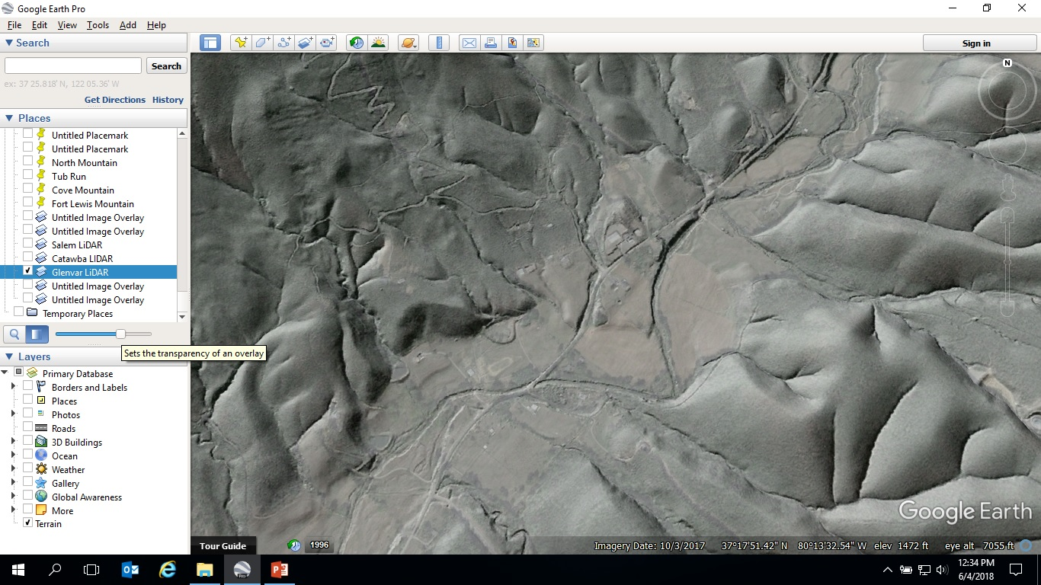
Once the overlay is uploaded, do a bit of QC…
Click on the overlay name in the “Places” bar, and use the slider to fade it in and out. You can thus check the match between roads, building pads, etc on LiDAR vs. on the Google Earth imagery.
It will never be completely perfect, but we end up with non-systematic errors of just a few feet, even in rugged areas. It is possible to right-click on the overlay, select “Properties,” and re-open the location field and tweak margins if you identify a systematic error. This shouldn’t happen, however, if you trimmed carefully.

